Slide 1



Introduction to Neural Networks in the context of ABF
Ioannis Mallioras
PhD candidate
Maggioli SpA, Aristotle University of Thessaloniki 2024

Slide 2
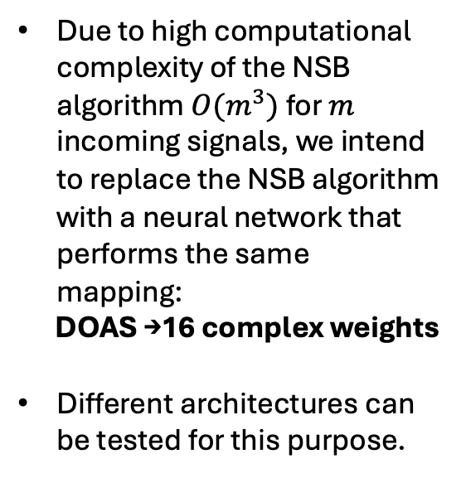
What is replaced by NNs?
Due to high computational complexity of the NSB algorithm $O(m^{3})$ for $m$ incoming signals, we intend to replace the NSB algorithm with a neural network that performs the same mapping:
DOAS →16 complex weights
Different architectures can be tested for this purpose.

Slide 3
Deep Feedforward Neural Network (FFNN)
Hidden Layers
The first approach is to use a simple FFNN.
The input enters the model simultaneously and is processed in parallel by the hidden layers of the model.
The output is a 32-valued vector that contains the real and imaginary parts of the weights.
Advantages
Lightweight
Easy to train
Disadvantages
Requires new model for different input size
Not as capable for highly complex tasks

Slide 4
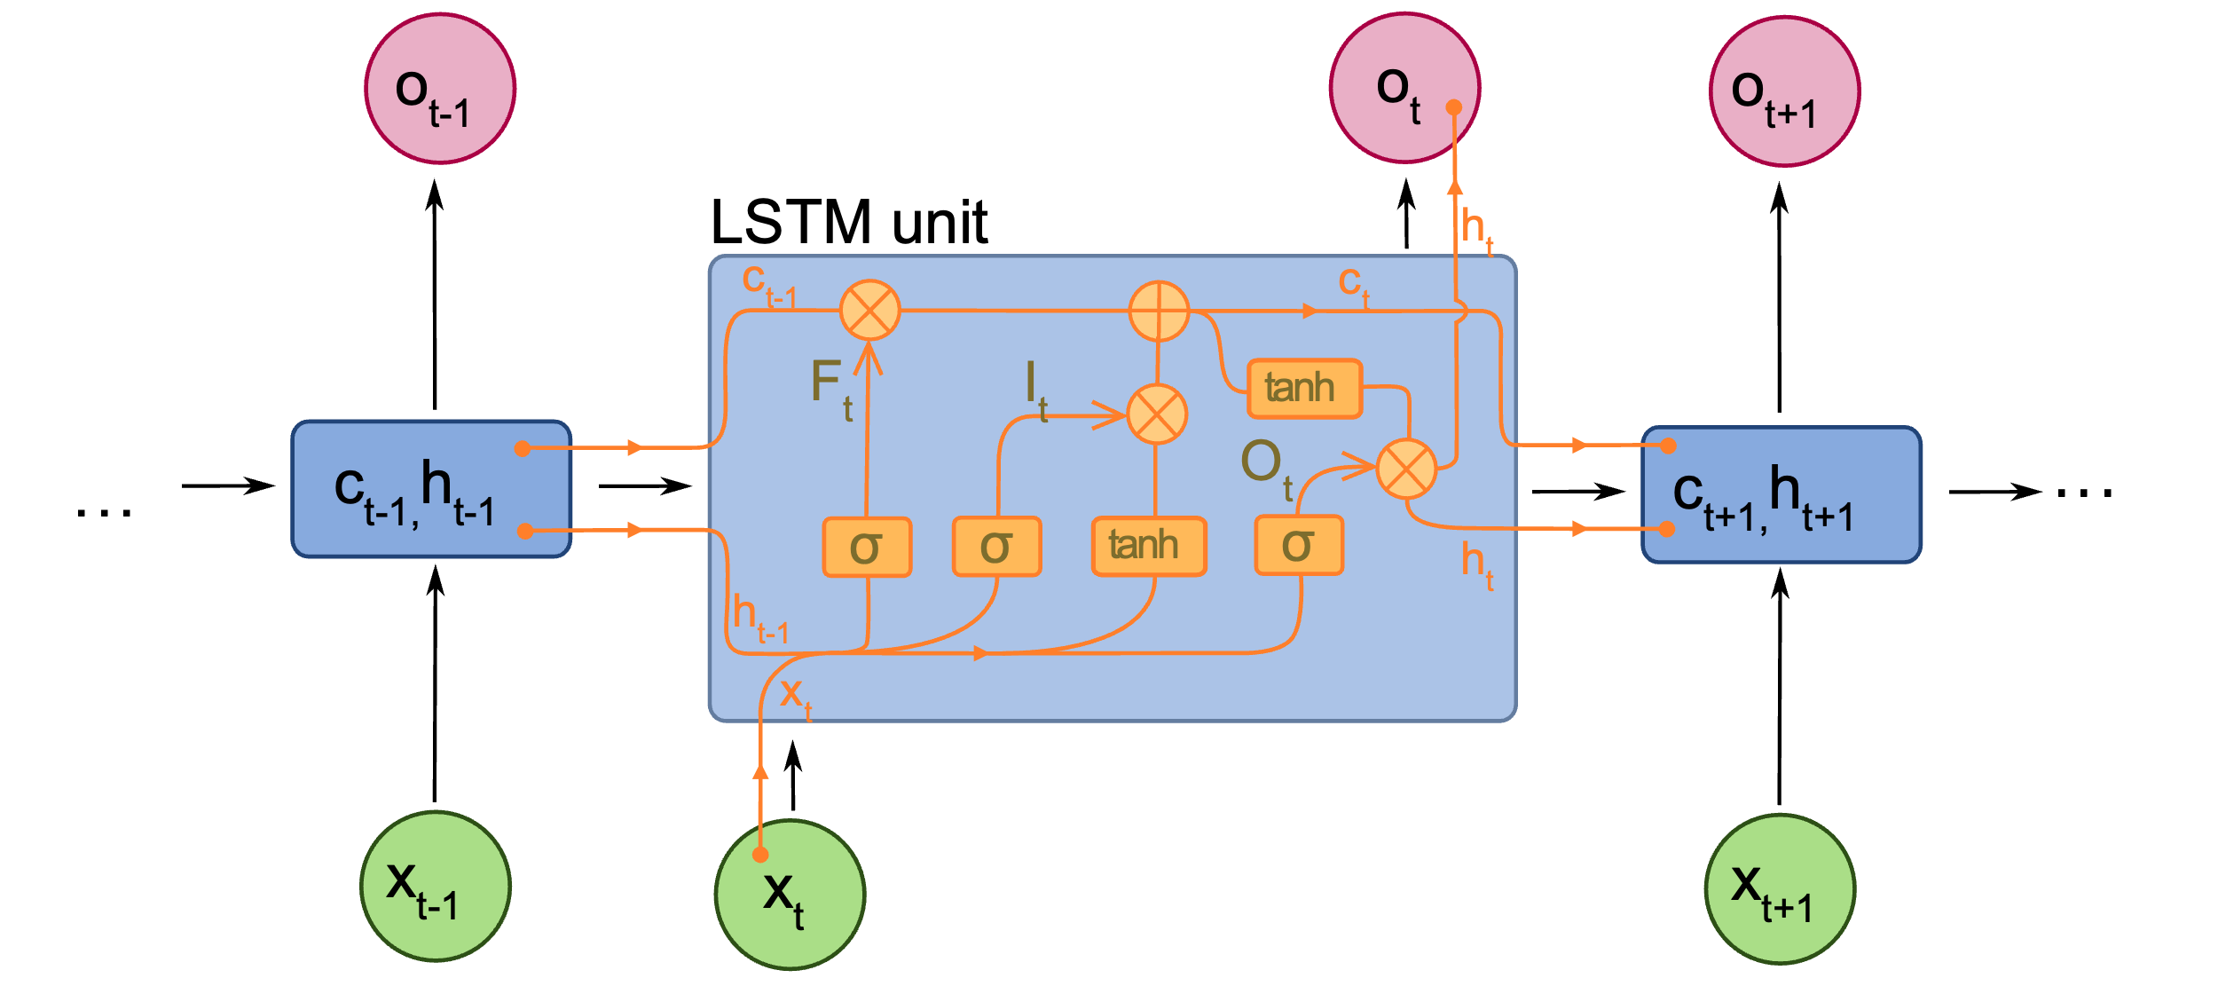
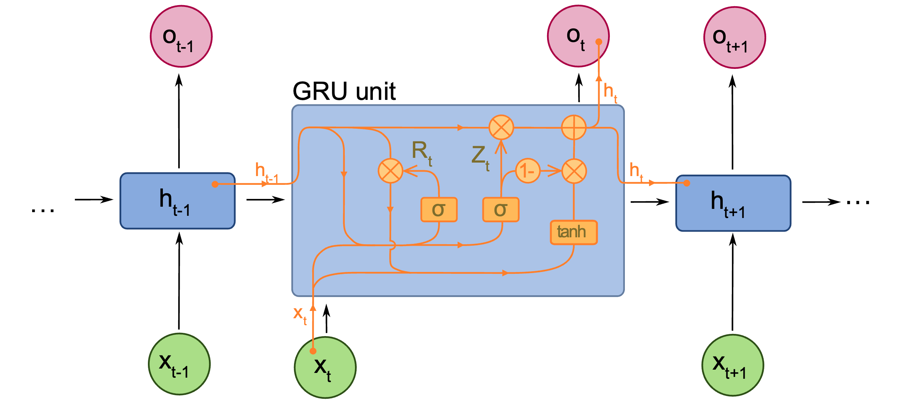
Recurrent Neural Network with LSTMs and GRUs
The second approach is to use an RNN with long short-term memory (LSTM) units and gated-recurrent units (GRUs).
The input enters the model at different time-steps and information from previous timesteps is passed down to subsequent ones.
The output contains the real and imaginary parts of the weights, but we use a trainable linear transformation layer to “translate” the hidden state into a 32-valued vector.
Image Source: https://en.wikipedia.org/wiki/Recurrent_neural_network

Slide 5
Hyperparameter Tuning (grid search)
FFNN Tuning
LSTM & GRU Tuning

